Slide 2
Antra SEP Program
Dapper
Day 17

Slide 3
What’s Dapper?
Dapper is a simple object mapper for .NET and own the title of King of Micro ORM in terms of speed and is virtually as fast as using a raw ADO.NET data reader. An ORM is an Object Relational Mapper, which is responsible for mapping between database and programming language.
Dapper extend the IDbConnection by providing useful extension methods to query our database.

Slide 4
Why Dapper
Dapper is the second fastest ORM.
Perform CRUD operations directly using IDBConnection object.
Provide querying static and dynamic data over database.
Get generic result for simple or complex data type.
Dapper allow to store bulk data at once.

Slide 5
How Dapper Works?
It is a three step process.
Create an IDbConnection object.
Write a query to perform CRUD operations.
Pass query as a parameter in Execute method.

Slide 6
Installation
There are two ways to install Dapper:
DapperMappingFileForC#4.5.cs. Add this Program.cs file to project and get started with Dapper functionality. We can SqlMapperAsync.cs depending on the .Net framework use.
NuGet package Manager. In Visual Studio, create a new console project and in Solution Explorer right-click References and select Manage NuGet package Manager and search for Dapper and using the NuGet Package Manager Console command for the Nugget Package Manager “install-package dapper”, and this will install Dapper into project.

Slide 7
Requirement
Dapper work with any database provider since there is no DB specific implementation.

Slide 8
Methods
Dapper will extend IDbConnection interface with multiple methods:
Execute
Query
QueryFirst
QueryFirstOrDefault
QuerySingle
QuerySingleOrDefault
QueryMultiple

Slide 9
Dapper – Execute
Execute is an extension method which can be called from any object of type IDbConnection. It can execute a command one or multiple times and return the number of affected rows. This method is usually used to execute:
Stored Procedure
INSERT Statement
UPDATE Statement
DELETE Statement

Slide 10
Parameters
The following table shows different parameter of an Execute method.
Name | Description
sql | The command text to execute.
param | The command parameters (default = null).
transaction | The transaction to use (default = null).
commandTimeout | The command timeout (default = null)
commandType | The command type (default = null)

Slide 11
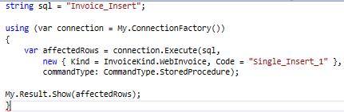
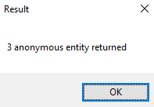
Example – Stored Procedure (Single)
Execute the Stored Procedure a single time.

Slide 12
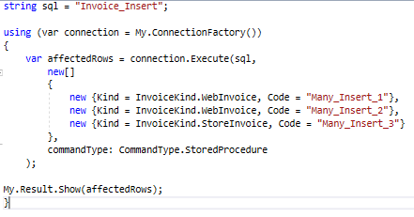
Example – Stored Procedure (Many)
Execute the Stored Procedure multiple times. Once for every object in the array list.

Slide 13
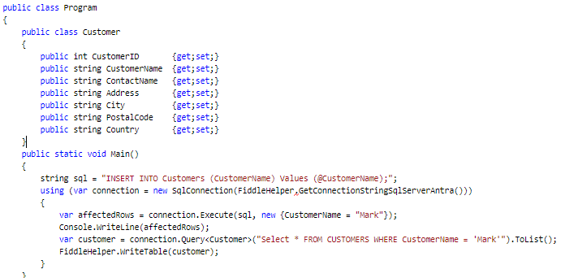
Example – INSERT (Single)
Execute the INSERT Statement a single time.

Slide 14
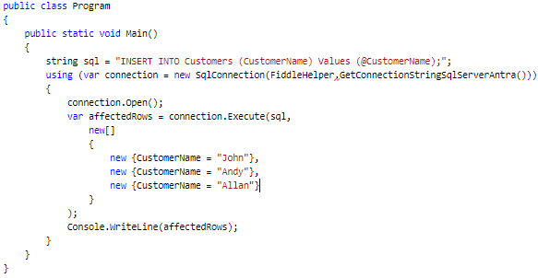
Example – INSERT (Many)
Execute the INSERT Statement multiple times. Once for every object in the array list.
Output: 3

Slide 15
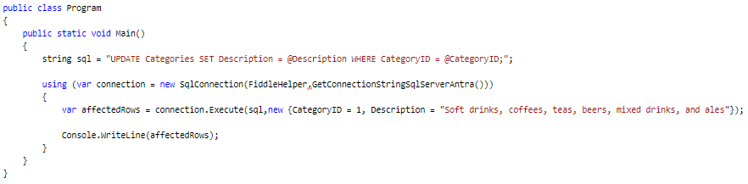
Example – UPDATE (Single)
Execute the UPDATE Statement a single time.
Output: 1

Slide 16
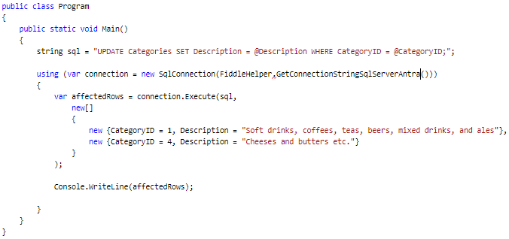
Example – UPDATE (Many)
Execute the UPDATE Statement multiple times. Once for every object in the array list.
Output: 2

Slide 17
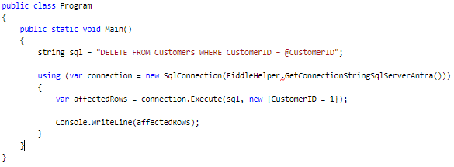
Execute – DELETE (Single)
Execute the DELETE Statement a single time.
Output: 1

Slide 18
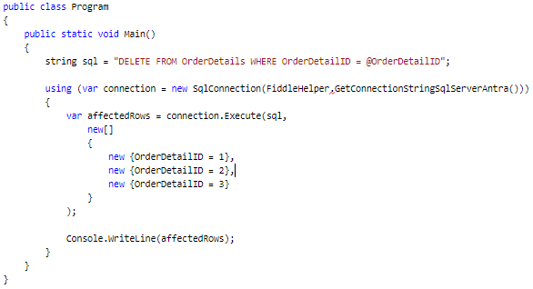
Execute – DELETE (Many)
Execute the DELETE Statement multiple times. Once for every object in the array list.
Output: 3

Slide 19
Dapper – Query
Query method is an extension method which can be called from any object of type IDbConnection. It can execute a query and map the result.
The result can be mapped to:
Anonymous
Strongly Typed
Multi-Mapping (One to One)
Multi-Mapping (One to Many)
Multi-Type

Slide 20
Parameters
The following table shows different parameter of an Query method.
Name | Description
sql | The query to execute.
param | The query parameters (default = null).
transaction | The transaction to use (default = null).
buffered | True to buffer reading the results of the query (default = true).
commandTimeout | The command timeout (default = null)
commandType | The command type (default = null)

Slide 21
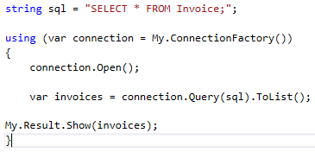
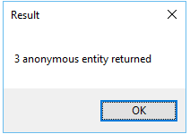
Example – Query Anonymous
Raw SQL query can be executed using Query method and map the result to a dynamic list.

Slide 22
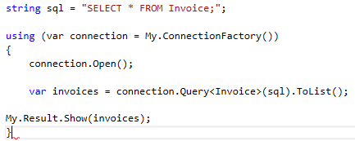
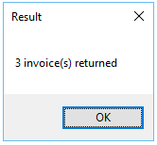
Example – Query Strongly Typed
Raw SQL query can be executed using Query method and map the result to a strongly typed list.

Slide 23
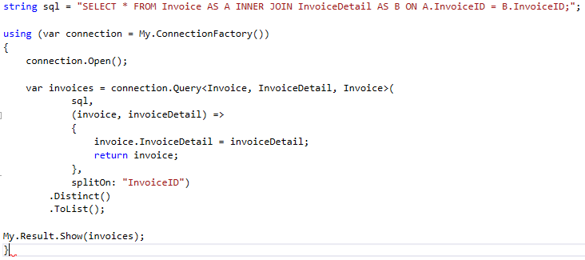
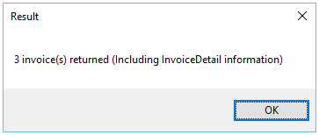
Example – Query Multi-Mapping (One to One)
Raw SQL query can be executed using Query method and map the result to a strongly typed list with a one to one relation.

Slide 24
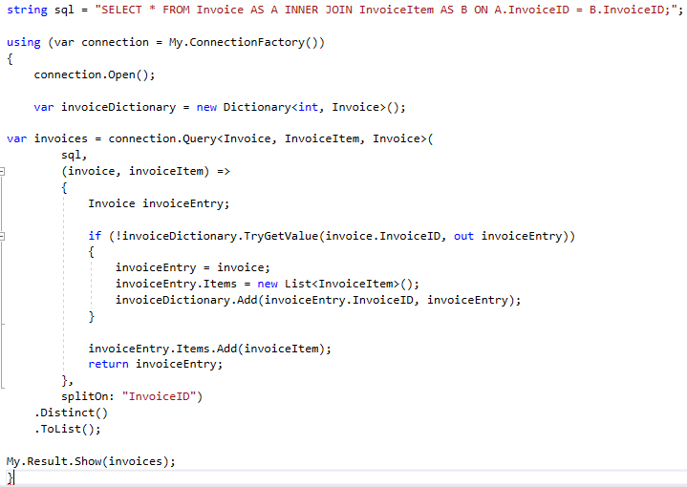
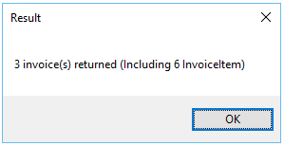
Example – Query Multi-Mapping (One to Many)
Raw SQL query can be executed using Query method and map the result to a strongly typed list with a one to many relations.

Slide 25
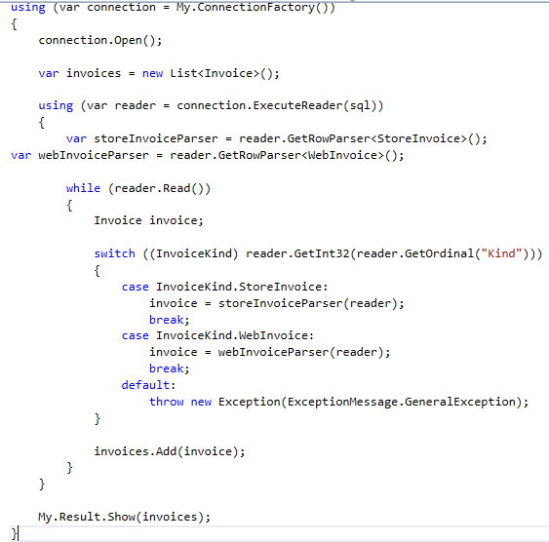
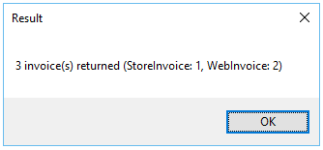
Query Multi-Type
Raw SQL query can be executed using Query method and map the result to a list of different types.

Slide 26
QueryFirst
QueryFirst method is an extension method which can be called from any object of type IDbConnection. It can execute a query and map the first result.
The result can be mapped to:
Anonymous
Strongly Typed

Slide 27
Parameters
The following table shows different parameter of an QueryFirst, QueryFirstOrDefault, QuerySingle, QuerySingleOrDefalut, QueryMultiple method.
Name | Description
sql | The query to execute.
param | The query parameters (default = null).
transaction | The transaction to use (default = null).
commandTimeout | The command timeout (default = null)
commandType | The command type (default = null)

Slide 28
First, Single & Default
First & Single methods are very different.
Result | No Item | One Item | Many Items
First | Exception | Item | First Item
Single | Exception | Item | Exception
FirstOrDefault | Default | Item | First Item
SingleOrDefault | Default | Item | Exception

Slide 29
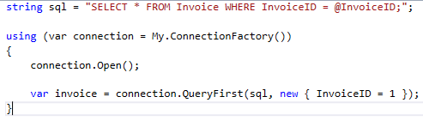
Example – Query Anonymous
Execute a query and map the first result to a dynamic list.

Slide 30
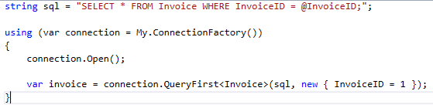
Example – Query Strongly Typed
Execute a query and map the first result to a strongly typed list.

Slide 31
QueryFirstOrDefault
QueryFirstOrDefault method is an extension which can be called from any object of type IDbConnection. It can execute a query and map the first result, or a default value if the sequence contains no elements.
The result can be mapped to:
Anonymous
Strongly Typed

Slide 32
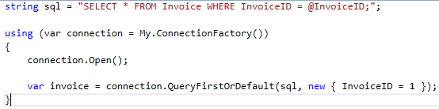
Example – Query Anonymous
Execute a query and map the first result to a dynamic list, or a default value if the sequence contains no elements.

Slide 33
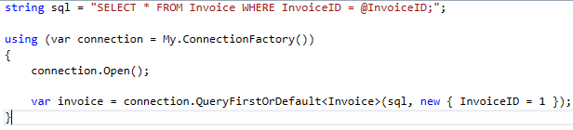
Example – Query Strongly Typed
Execute a query and map the first result to a strongly typed list, or a default value if the sequence contains no elements.

Slide 34
QuerySingle
QuerySingle method is an extension method which can be called from any object of type IDbConnection. It can execute a query and map the first result, and throws an exception if there is not exactly one element in the sequence.
The result can be mapped to:
Anonymous
Strongly Typed

Slide 35
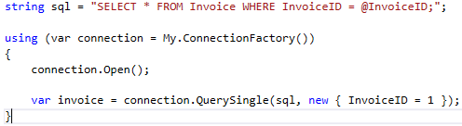
Example – Query Anonymous
Execute a query and map the first result to a dynamic list, and throws an exception if there is not exactly one element in the sequence.

Slide 36
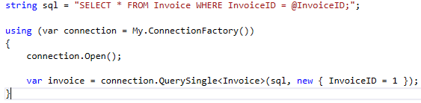
Example – Query Strongly Typed
Execute a query and map the first result to a strongly typed list, and throws an exception if there is not exactly one element in the sequence.

Slide 37
QuerySingleOrDefault
QuerySingleOrDefault method is an extension method which can be called from any object of type IDbConnection. It can execute a query and map the first result, or a default value if the sequence is empty; this method throws an exception if there is more than one element in the sequence.
The result can be mapped to:
Anonymous
Strongly Typed

Slide 38
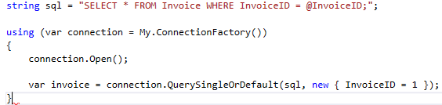
Example – Query Anonymous
Execute a query and map the first result to a dynamic list, or a default value if the sequence is empty; this method throws an exception if there is more than one element in the sequence.

Slide 39
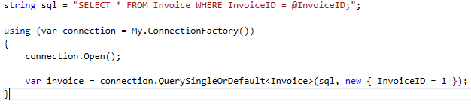
Example – Query Strongly Typed
Execute a query and map the first result to a strongly typed list, or a default value if the sequence is empty; this method throws an exception if there is more than one element in the sequence.

Slide 40
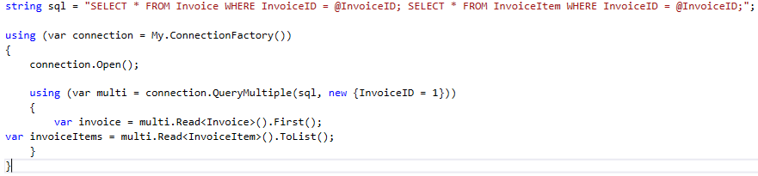
Query Multiple
QueryMultiple method is an extension method which can be called from any object of type IDbConnection. It can execute multiple queries within the same command and map results.

Slide 41
Parameter Anonymous
Dapper make it simple & safe (SQL Injection) to use parameter by supporting anonymous type.

Slide 42
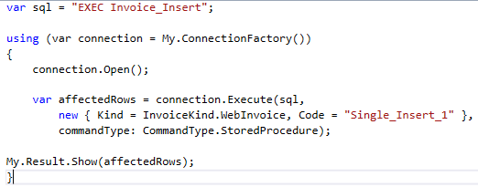
Parameter Anonymous (Single)
Execute a single time a SQL Command.

Slide 43
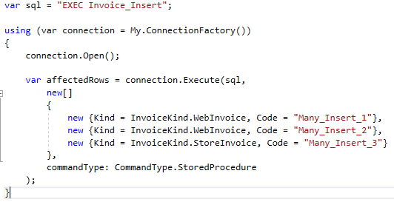
Parameter Anonymous (Multiple)
Execute many times a SQL Command

Slide 44
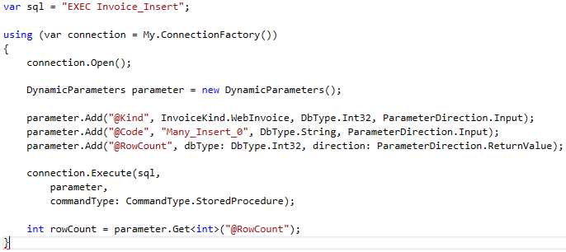
Parameter Dynamic
Create and use a parameter in a Dapper method.
Single
Execute a single time a SQL command.

Slide 45
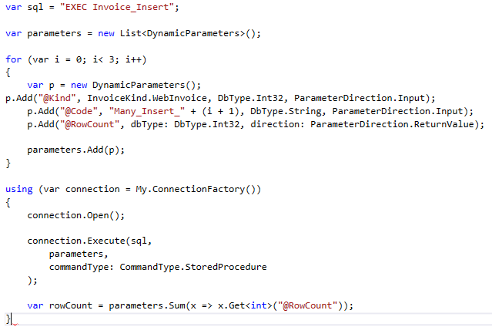
Parameter Dynamic (Many)
Execute many times a SQL Command.

Slide 46
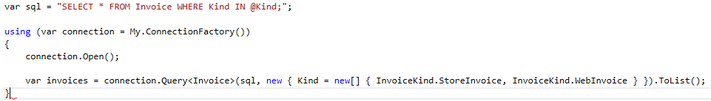
Parameter List
Dapper allow you to specify multiple parameter on a IN clause by using a list.

Slide 47
Result Anonymous
Extension methods can be used to execute a query and map the result using dynamic.
The anonymous result can be mapped from following extension methods:
Query
QueryFirst
QueryFirstOrDefault
QuerySingle
QuerySingleOrDefault
These extension methods can be called from any object of type IDbConnection.

Slide 48
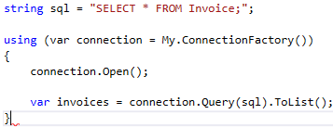
Example – Query
Query method can execute a query and map the result to a dynamic list.

Slide 49
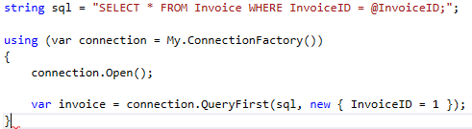
Example - QueryFirst
QueryFirst method can execute a query and map the first result to a dynamic list.

Slide 50
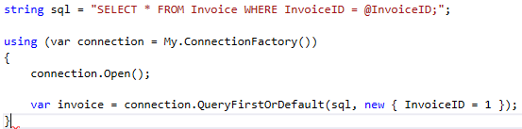
Example - QueryFirstOrDefault
QueryFirstOrDefault method can execute a query and map the first result to a dynamic list, or a default value if the sequence contains no elements.

Slide 51
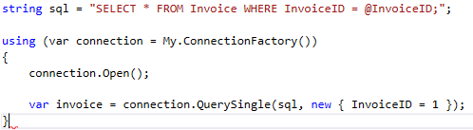
Example - QuerySingle
QuerySingle method can execute a query and map the first result to a dynamic list, and throws an exception if there is not exactly one element in the sequence.

Slide 52
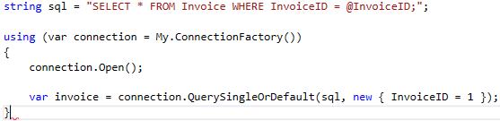
Example – QuerySingleOrDefault
QuerySingleDefaut method can execute a query and map the first result to a dynamic list, or a default value if the sequence is empty; this method throws an exception if there is more than one element in the sequence.

Slide 53
Result Strongly Typed
Extension methods can be used to execute a query and map the result using strongly typed.
The anonymous result can be mapped from following extension methods:
Query
QueryFirst
QueryFirstOrDefault
QuerySingle
QuerySingleOrDefault
These extension methods can be called from any object of type IDbConnection.

Slide 54
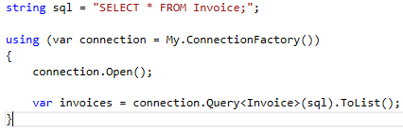
Example – Query
Query method can execute a query and map the result to a strongly typed list.

Slide 55
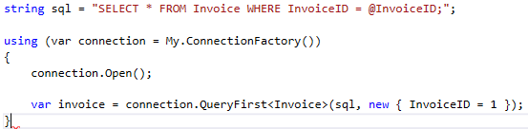
Example – QueryFirst
QueryFirst method can execute a query and map the first result to a strongly typed list.

Slide 56
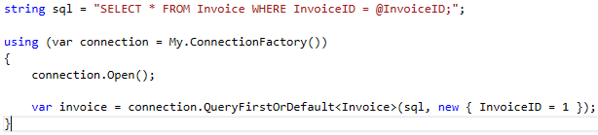
Example - QueryFirstOrDefault
QueryFirstOrDefault method can execute a query and map the first result to a strongly typed list, or a default value if the sequence contains no elements.

Slide 57
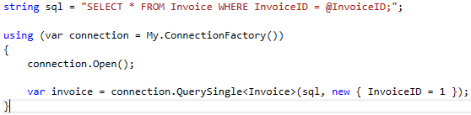
Example – QuerySingle
QuerySingle method can execute a query and map the first result to a strongly typed list, and throws an exception if there is not exactly one element in the sequence.

Slide 58
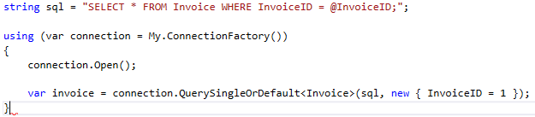
Example - QuerySingleOrDefault
QuerySingleOrDefault method can execute a query and map the first result to a strongly typed list, or a default value if the sequence is empty; this method throws an exception if there is more than one element in the sequence.

Slide 59
Result Multi-Mapping
Extension methods can be used to execute a query and map the result to a strongly typed list with relations.
The relation can be either:
One to One
One to Many
These extension methods can be called from any object of type IDbConnection.

Slide 60
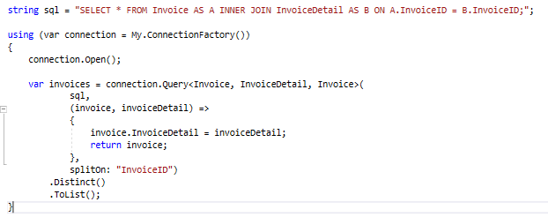
Example – Query Multi-Mapping (One to One)
Query method can execute a query and map the result to a strongly typed list with a one to one relation.

Slide 61
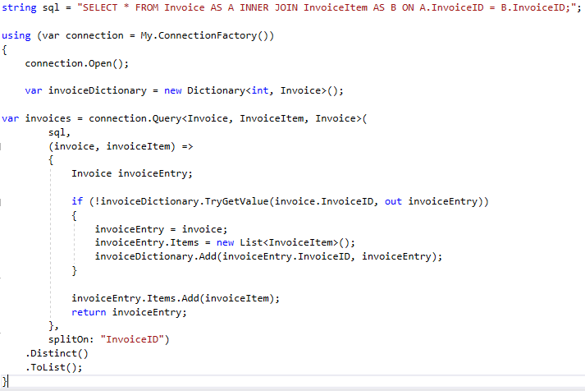
Example- Query Multi-Mapping (One to Many)
Query method can execute a query and map the result to a strongly typed list with a one to many relations.

Slide 62
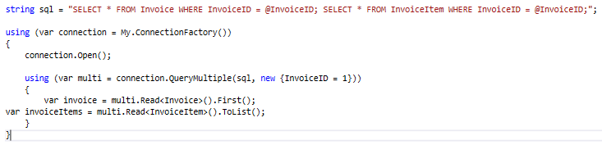
Result Multi-Result
QueryMultiple method is an extension method which can be called from any object of type IDbConnection. It can execute multiple queries within the same command and map results.

Slide 63
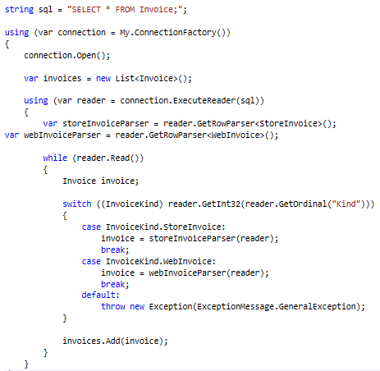
Result Multi-Type
ExecuteReader method is an extension method which can be called from any object of type IDbConnection. It can execute a query and map the result to a list of different types.

Slide 64
Async
Dapper also extend the IDbConnection interface with Async (asynchronous) methods:
ExecuteAsync
QueryAsync
QueryFirstAsync
QueryFirstOrDefaultAsync
QuerySingleAsync
QuerySingleOrDefaultAsync
QueryMultipleAsync

Slide 65
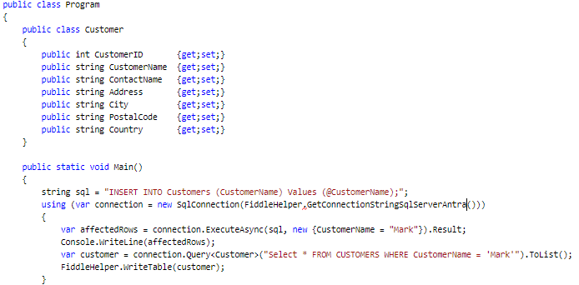
ExecuteAsync

Slide 66
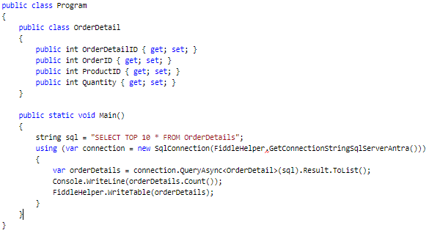
QueryAsync

Slide 67
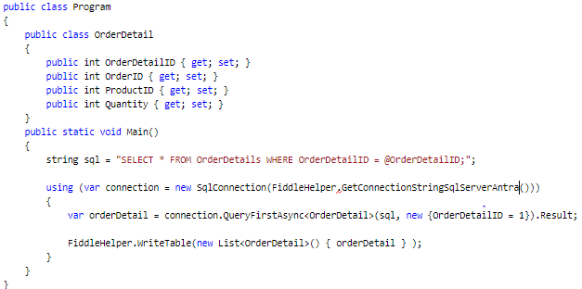
QueryFirstAsync

Slide 68

QueryFirstOrDefaultAsync

Slide 69

QuerySingleAsync

Slide 70

QuerySingleOrDefaultAsync

Slide 71

QueryMultipleAsync

Slide 72

Buffered
Default: True
A buffered query return the entire reader at once. That is ideal in most scenario.
A non-buffered query is equivalent as streaming. You only load objects on demand. That can be useful for a very large query to reduce memory usage.

Slide 73

Transaction
Dapper support the transaction and TransactionScope
Begin a new transaction from the connection and pass it in the transaction optional parameter.

Slide 74

Transaction Scope
Begin a new transaction scope before starting the connection

Slide 75
Store Procedure
Using Stored Procedure in Dapper is very easy, simply need to specify the command type

Slide 76

Execute Single
Execute a Stored Procedure a single time.

Slide 77

Execute Many
Execute a Stored Procedure multiple times.

